Slide 1
Variability Along Martian Wrinkle Ridges
Arizona Space Grant Consortium
University of Arizona
Morgan Cryder
Jeff Andrews-Hanna
April 2021
Wrinkle Ridge in Lunae Planum
Notes:
*might consider adding a picture here. If you do a picture in the background, it should be very muted (transparent) so that it is easy to still see the text. Or could put something along the sides or bottom

Slide 2
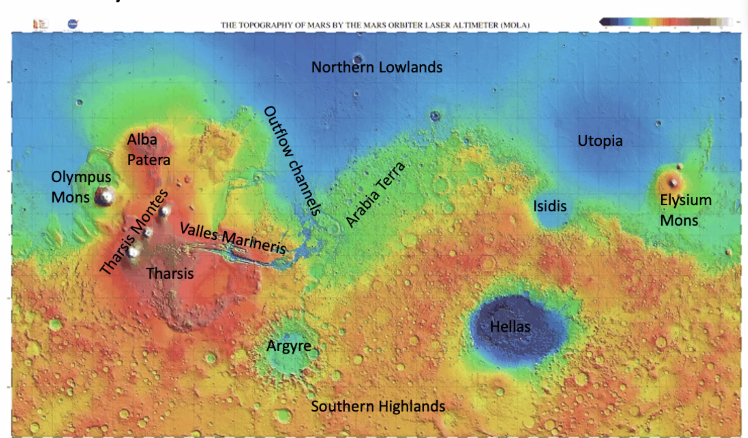
Martian Tectonics
What are Martian Tectonics?
structure of the crust of Mars especially with the formation of folds and faults in it
By studying tectonics on Mars, we learn more about the geophysical evolution
Tharsis
Tectonic Hotspot
Solis and Lunae Planums
MOLA (Mars Orbiter Laser Altimeter)
Notes:
*try to find a better definition of “tectonics”
*”geophysical evolution”
Studying Martain tectonics will tell us about the large scale processes occurring on mars that could affect the subsurface structure. One region of Mars that is orientted towardds studying martian tectonics is the Tharsis region. Tharis is known to undergo tectonic processes that have caused extensive crustal deformation. this area is actually Solis and Lunae Planum, home to the wrinkle ridges of this study.

Slide 3
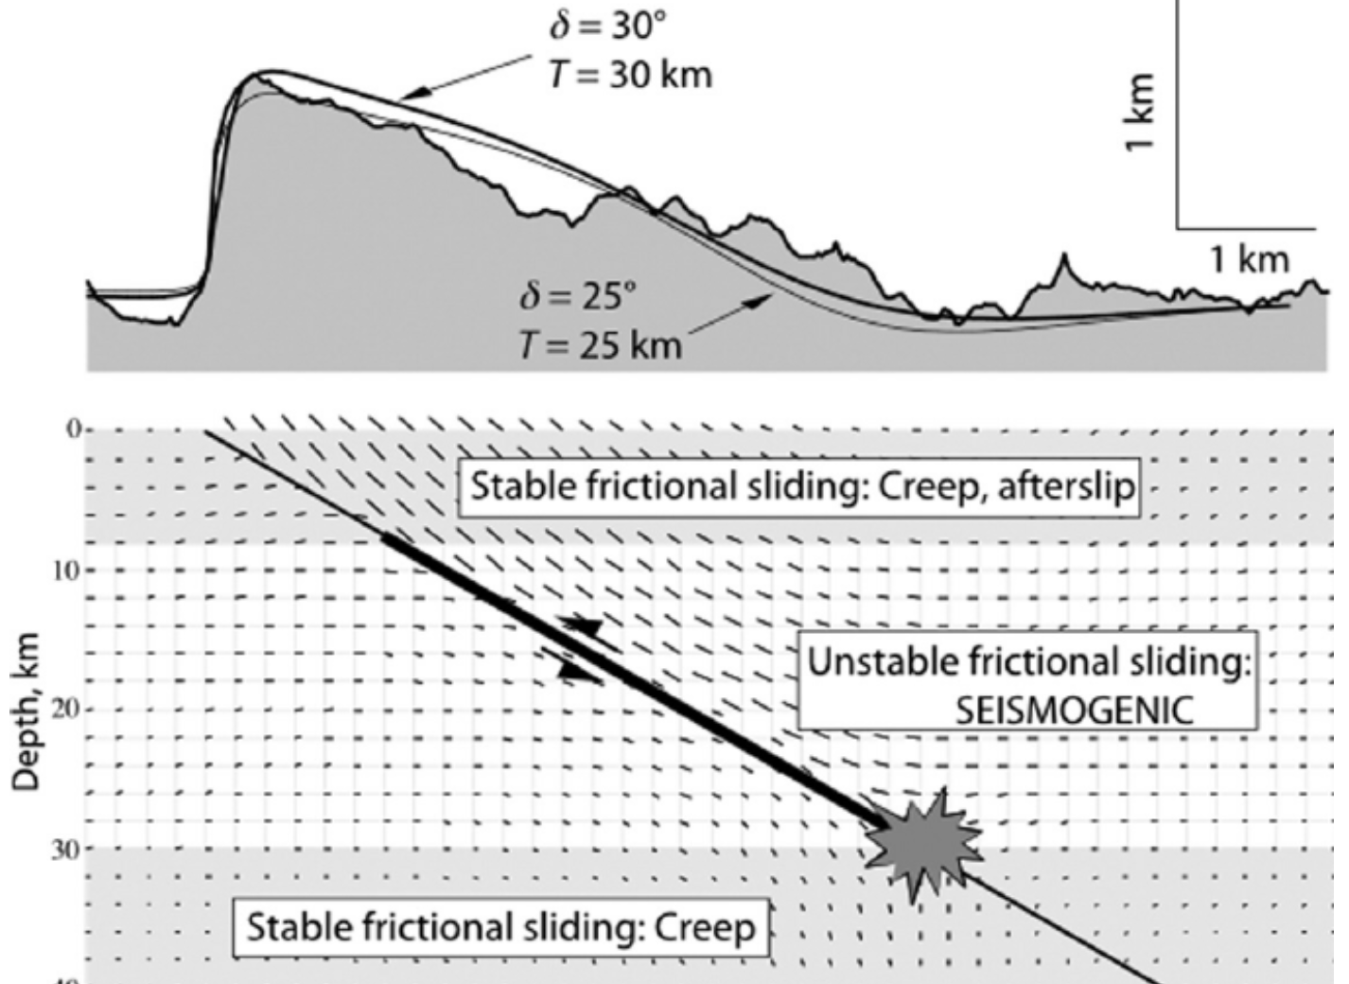
Wrinkle Ridges Background
Folds meditated by layer-parallel slip above blind thrust faults and back thrusts in volcanic surfaces
USGS 2014
Okubo & Schultz 2004
Model of the geometry of faults beneath a wrinkle ridge
Wrinkle ridges are compressional tectonic structures that are observed in numerous amounts on the surface of Mars
Notes:
Amethyst Rupes
What are wrinkle ridges? Wrinkle ridges are are compressional tectonic structures that are observed in numerous amounts on the surface of Mars. Here in the diagram, we can see a basic blind thrust fault resulting in the ductole rock layer fold. In the below image we can see the topography of a wrinkle ridge in Lynae planum.

Slide 4
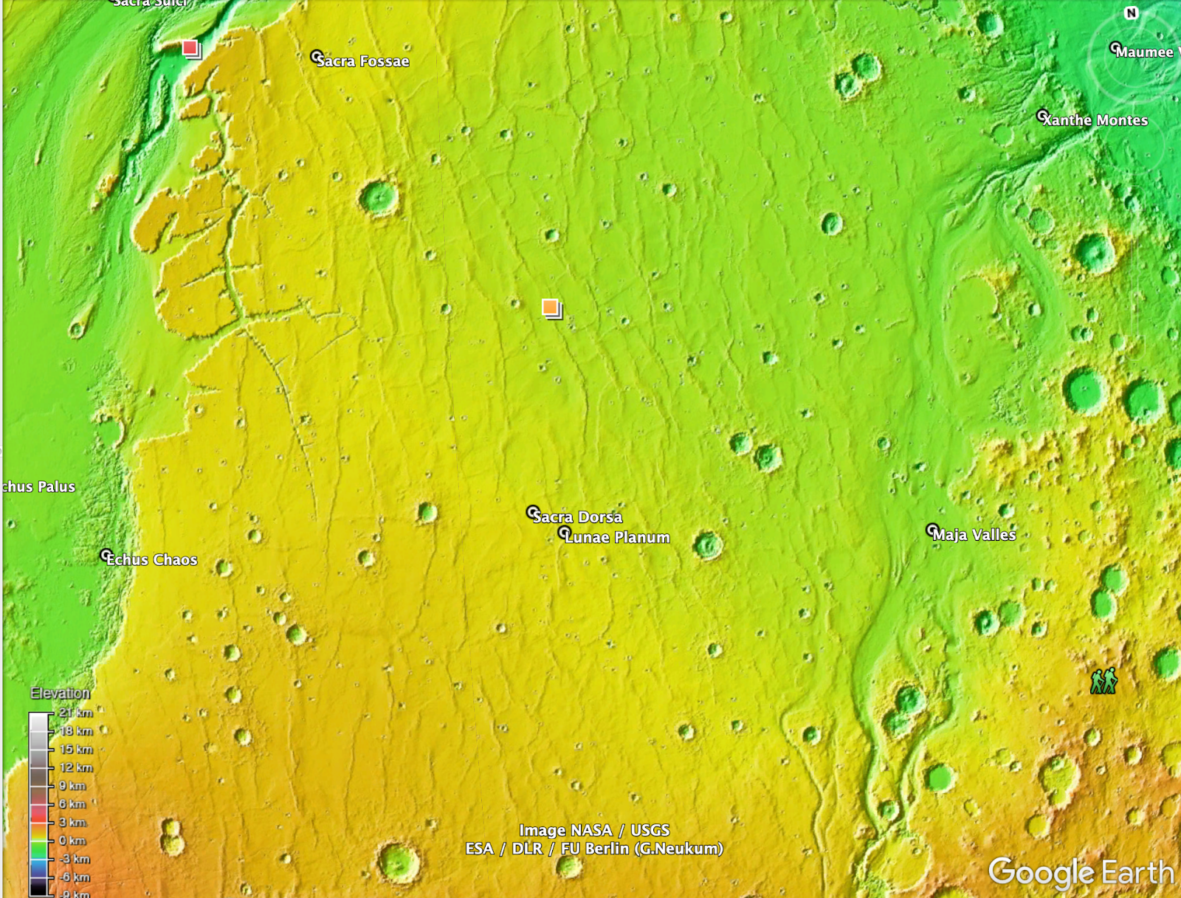
Goals and Motivations
How much variability is there within a single wrinkle ridge?
How much variability is there within a population of wrinkle ridges?
How does this relate to the subsurface structure of wrinkle ridges?
Lunae Planum in Colorized Terrain
Notes:
*should be “goals… are” rather than is
*could delete first bullet – redundant with title
Most studies focusing on the wrinkle ridges of mars . However, the variability of these ridges is frequently less studied. So this project focuses on that variability and how to exactly measure that.

Slide 5
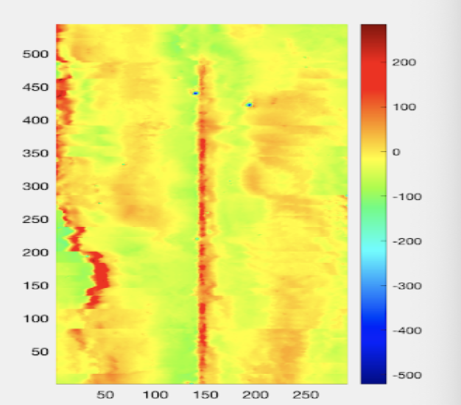
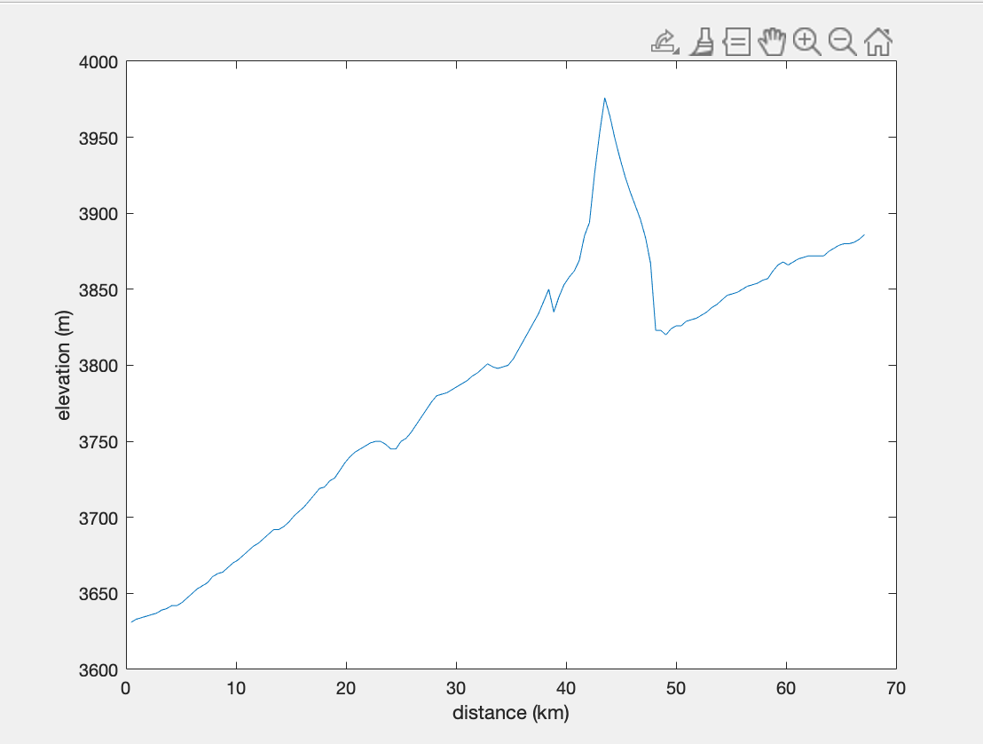
Methods
Dataset: topography from MOLA (Mars Orbiter Laser Altimeter)
Generate large number of profiles perpendicular to wrinkle ridges of interest
Color Map
Profiles
Notes:
*first bullet – don’t need to talk about receiving, can just say “Data: topography from MOLA (…”

Slide 6
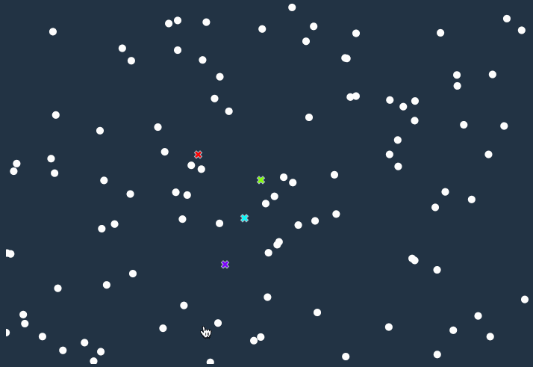
K – Means Analysis
Algorithm that groups similar data points together and discover underlying patterns
We are clustering profiles themselves and this will help us determine which profiles are more similar to each other
Process:
(for n clusters)
Select n seed profiles at random
Find Euclidean distance of every profile
to each of the seed profiles
Group each profile with the closest (most similar) seed profile
Use average of each group as next set of seed profiles
Iterate
Pandey 2019
Notes:
*Nice animation
We are clustering profiles themselves and this will help us determine which profiles are more similar to each other.

Slide 7
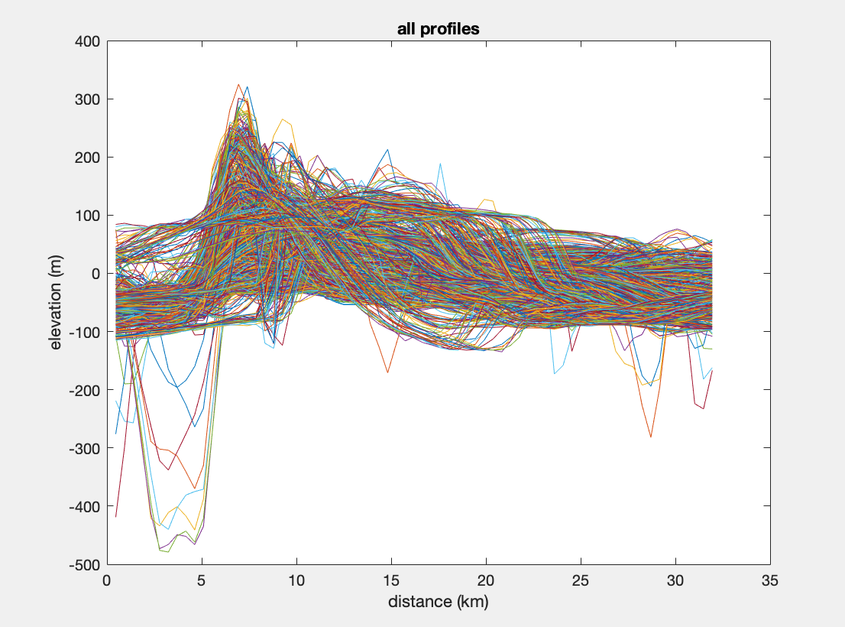
K – Means Application
Plot of all profiles on ridge
Plot of Final Average Profiles after K – Means Algoritm

Slide 8
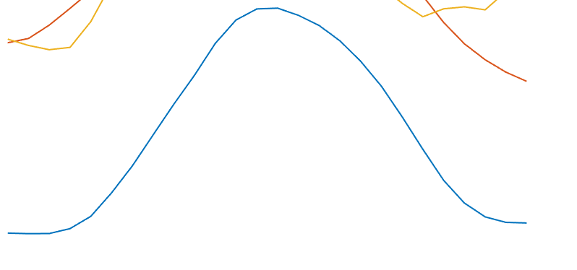
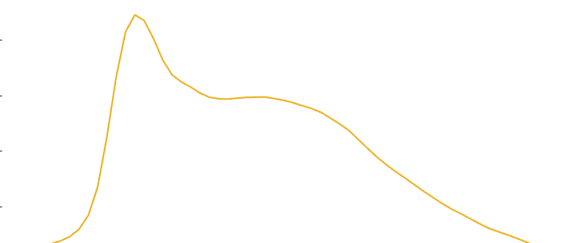
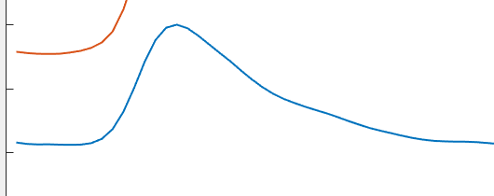
Classification of Topographic Profiles
Three types of profiles that wrinkle ridges are classified into:
Symmetric Ridge Morphology, Double Ridge Morphology, and a Ramp Morphology
Symmetric Ridge Morphology
Double Ridge Morphology
Ramp Morphology

Slide 9
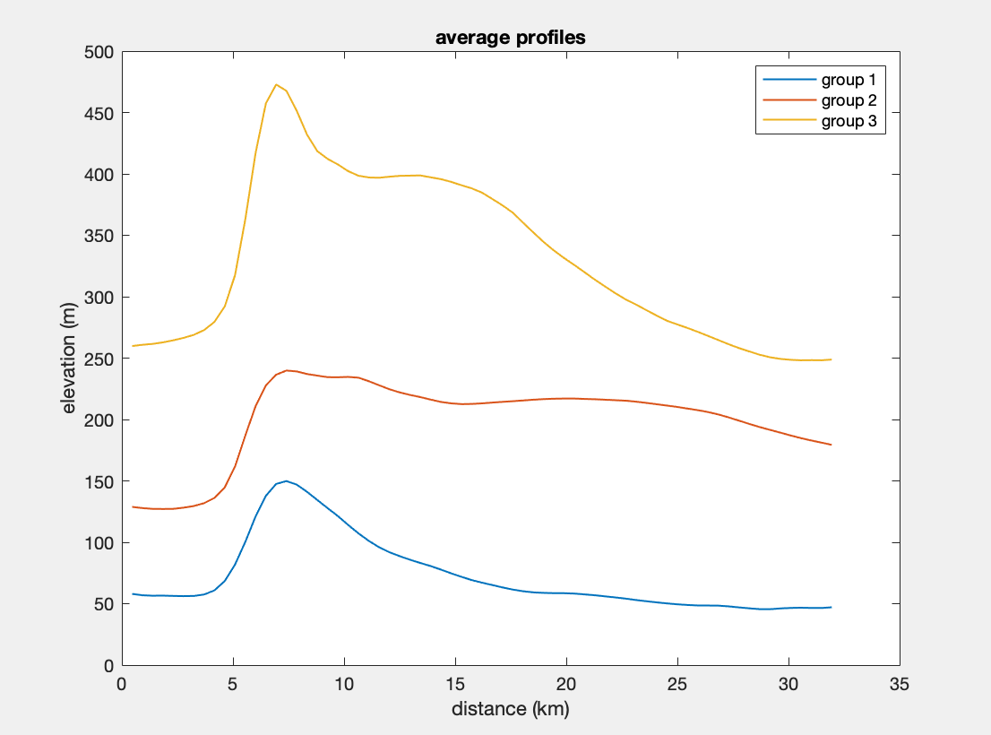
Individual Ridges Highlighted
Ridge 220
Solis Planum
Width : very variable
Elevation: Varies from ~100 m – 460 m
Type : Uniform Ramp to Double Ridge Morphology
Experiences variability throughout with width especially
K – Means Plot of Ridge 220
Location of the Profiles on Ridge
Notes:
*don’t worry about this for your presentation, but here is an observation for you. The second cluster appears to show a double morphology, but the profiles need to be extended further in length to show that clearly. This also reveals an important aspect of the variability. The double ridges in class 2 and 3 have very different widths for the wide ridge (but perhaps more similar narrow ridge widths). That indicates a very different arragenment of faults in the subsurface (maybe a backthrust nucleating at greater depth, or with shallower dip)

Slide 10
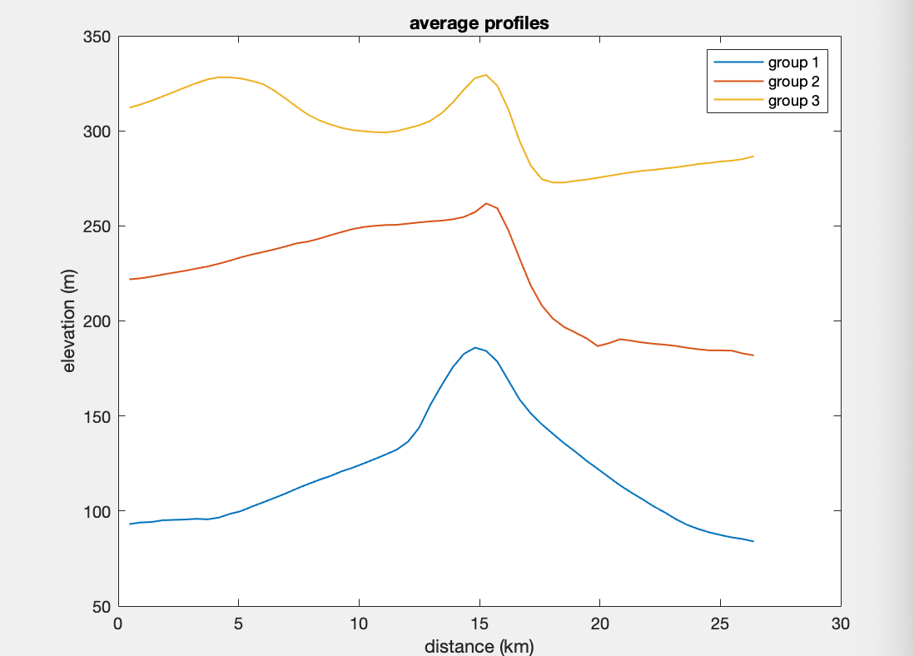
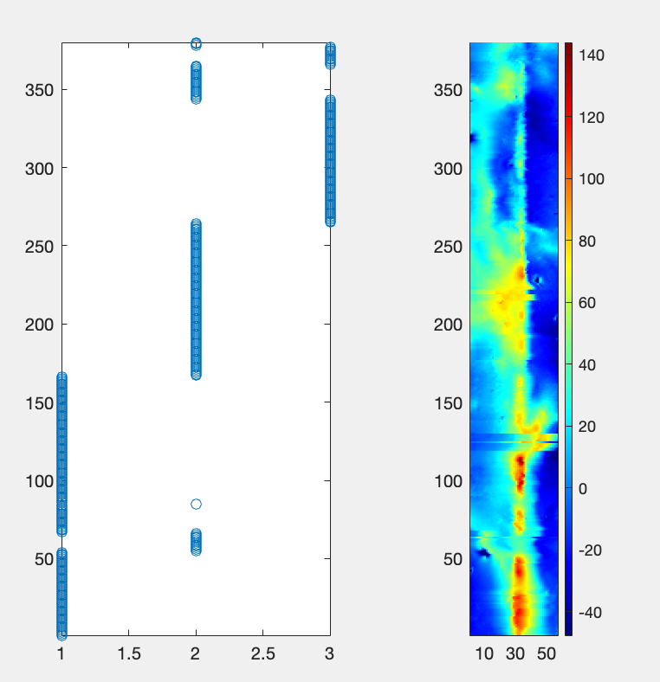
Individual Ridges Highlighted
Ridge 1198
Lunae Planum
Width : ~ 13 km (ramp)
Width : ~ 5 km (peak)
Height : Varies from elevations upwards ~170 m - 340 m
Type : Symmetric to ramp
This ridge demonstrates variability along its profiles, but also shows how messy ridges can be.
K – Means Plot of Ridge 1198
Location of the Profiles on Ridge
Notes:
*the first class here looks more symmetric than ramp style, maybe transitional between the two
Along with how ridges can be extremely messy.

Slide 11
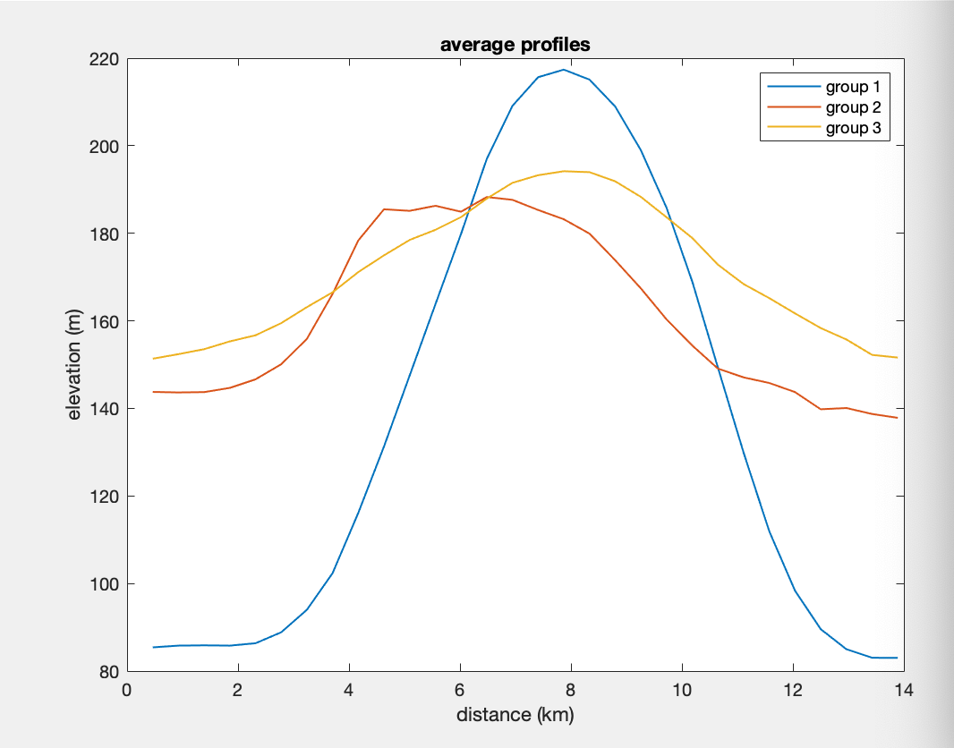
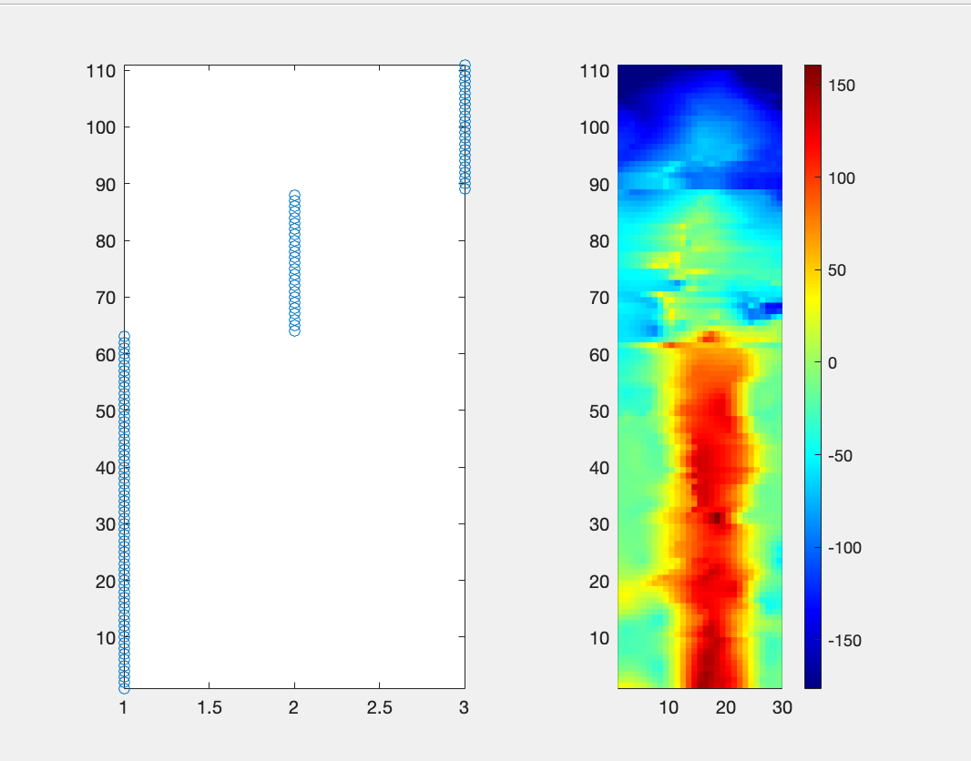
Individual Ridges Highlighted
Ridge 168
Solis Planum
Width : ~ 10 km
Elevation : ~ 220
Type : Consistent symmetrical morphology
Geology : Symmetrical back thrusts
Consistent morphology
K – Means Plot of Ridge 220
Location of the Profiles on Ridge

Slide 12
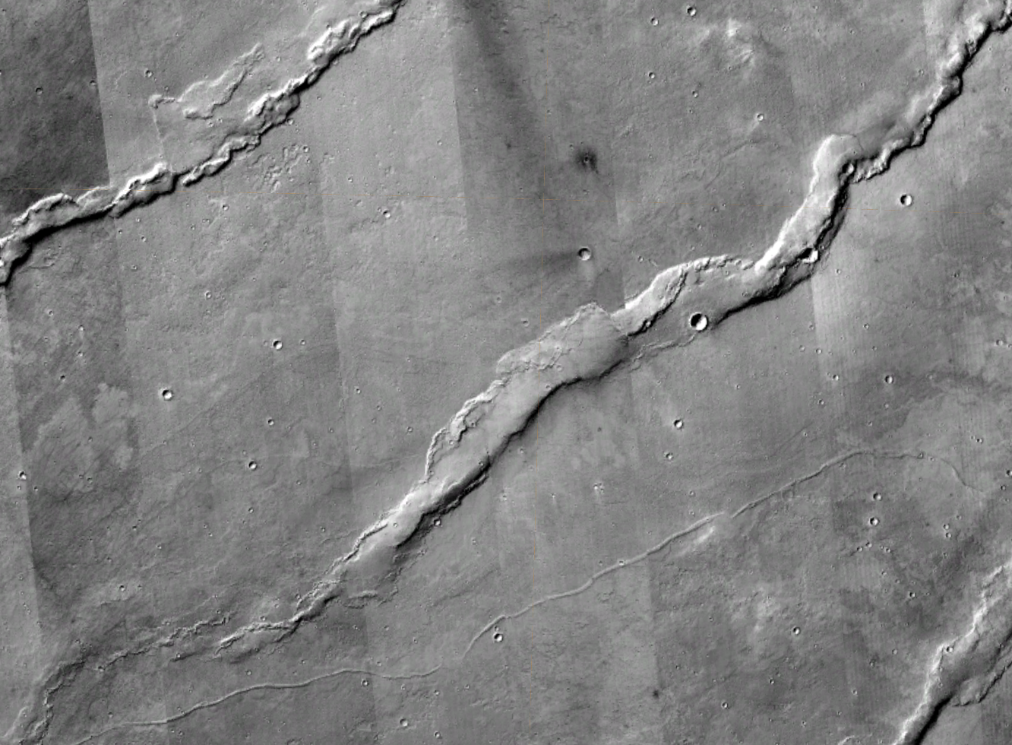
Conclusions
There is more than one type of morphology for wrinkle ridges
Double, Symmetric, Ramp
Double ridge morphology is most common
In a single ridge different morphologies may be present
Ridge width can vary (6-10 km)
Ridge height varies the most
Vergence direction remains consistent throughout except for rare cases
CTX Mosaic of Wrinkle Ridge in Solis Planum

Slide 13
Acknowledgements
I would like to say thank you to my mentor, Jeff Andrews-Hanna for working with me on this project and giving me an opportunity to learn so many new things. I would also like to thank the Space Grant team for giving me this chance to do this research.
Thank you again to everyone who supported me!

Slide 14
Thank you!

